Slide 1
Service Discovery and Clustering for .NET developers

Slide 2
Who are you?
Software Developer for over 20 years
Worked mainly for ISVs
Reuters, SunGard, Misys, Huddle
Worked for a couple of MIS departments
DTI, Beazley
Microsoft MVP for Visual Studio and Development Technologies
Interested in OO, SOA, EDA,, Messaging, REST
Interested in Agile methodologies and practices
No smart guys
Just the guys in this room

Slide 3

Intelligent collaboration for the Enterprise

Slide 4
@BrighterCommand

Slide 5
Agenda
Point-to-Point
Recap of a point-to-point solution
Availability
Point-to-Point solutions and availability
Discovery
Where are my services?
Client-Side Discovery
Static: Local Registry
Dynamic: Registrar
Dynamic: Self-Registration
Health Checks
Registering a health check for a service
Server-Side Discovery
Load Balancers
Load Balancers and Service Registration
Zero Configuration
Death to Configuration Files
Q&A

Slide 6
What You Will Learn From This Session
What is Service Discovery?
Why do you need it?
What are the patterns you need to know?
What are Zookeeper, Consul, etcd. for?
What do I need to understand about their differences?
How do I use them to implement the key patterns?
Service Discovery is straightforward
Notes:
This is intended as an introduction to the topic of Service Discovery
Once you know what it is, it’s quite simple to use it
Of course the trick is in knowing what it is, and that is the point of this presentation.
It’s not deep dive

Slide 7
Accessibility
If you have trouble reading the slides
You can download them here: https://github.com/iancooper/Presentations
You want: Service Discovery Long Form
If you want to view the code from the demo more easily
You find it here: https://github.com/iancooper/ServiceDiscovery-Tutorial
git clone git@github.com:iancooper/ServiceDiscovery-Tutorial.git

Slide 8
Point-to-Point

Slide 9
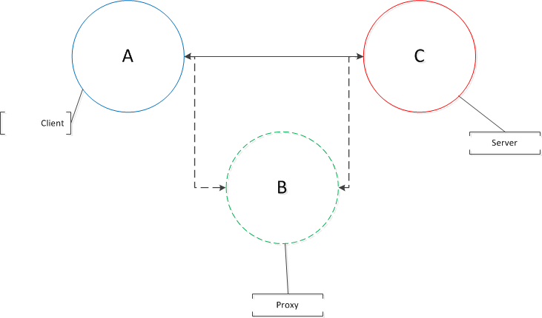

Slide 10
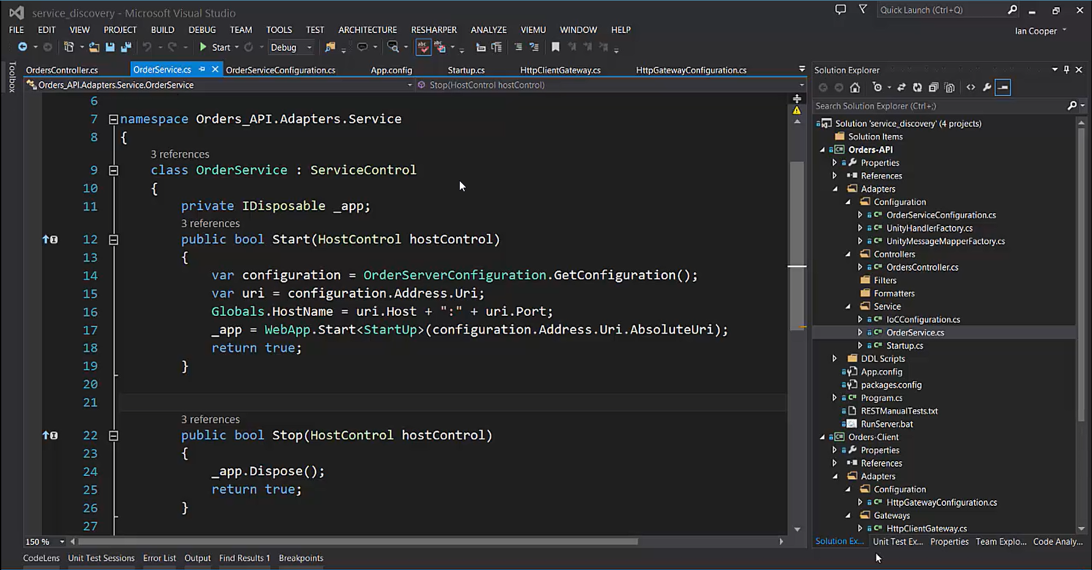
Demo: Point-to-Point
In this demo we will review point-to-point integration between an HTTP Server and a Client.
Although this model is simple, we will demonstrate its obvious weaknesses.
Next we will look to understand these issues, and solutions to them.

Slide 11
Availability
One of anything is bad

Slide 12
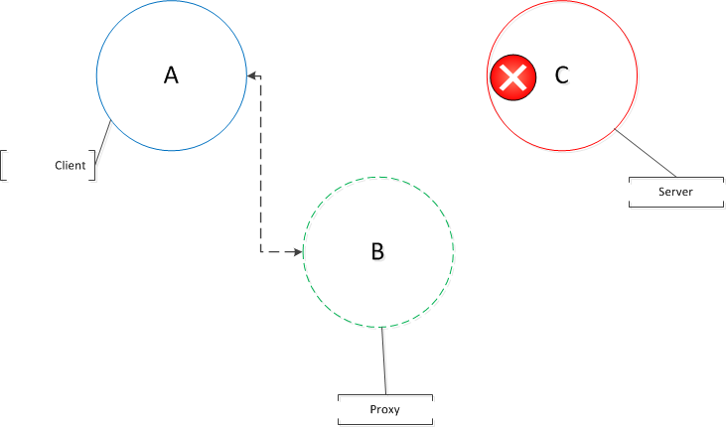

Slide 13
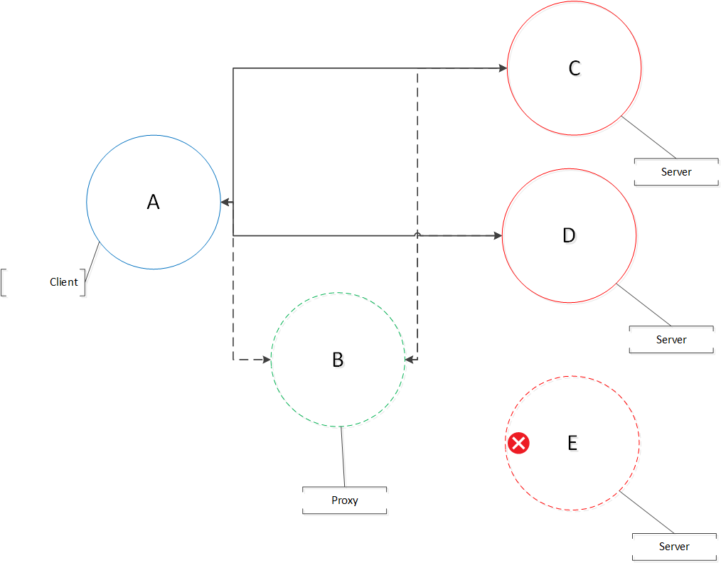
Notes:
Load Balancing
Load Balancing distributes work across multiple resources. This provides redundancy in the event that one instance is not available, allowing clients to meet their request from another service.
We have two groups of options:
Hardware of Software Load Balancers: their goal is to listen on a port and forward request on that port to a set of services – the pool of servers appears as one service to the client.
A load balancer can itself become an availability concern, unless it is deployed in a pair.
Round Robin: the client is made aware of the pool of servers and is chooses from amongst them.

Slide 14
Microservices = Operational Complexity
What do we mean by a microservices architecture?
Guerilla SOA++
- or -
Unix Pipes and Filters-style architecture
Whichever school you are in:
Your architecture now has many server side services that talk to each other.
If these are point-to-point: what happens when a service fails?
If you use a lightweight broker – what happens if the broker fails.

Slide 15
A microservices architecture forces you to consider availability.
You cannot have one of anything.
You must design for failure.

Slide 16
Discovery

Slide 17
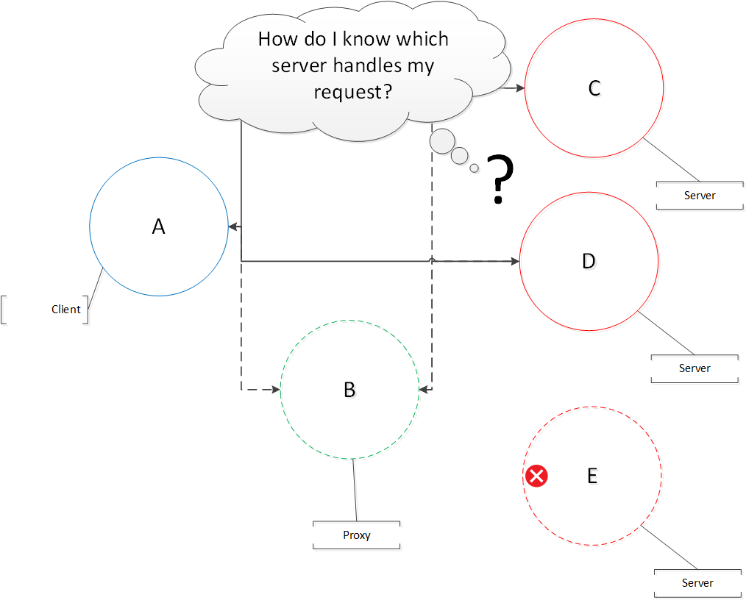

Slide 18
Where is my server?
Discovery
Redundancy introduces the question: how do I know who to talk to?
Instead of a single server, we now want to talk to a pool of servers, so that we can find an alternative if one of our servers is unavailable.
Discovery is the process of a client retrieving all the servers that make up a pool, which allows it load balance between them.

Slide 19
Client or Server-Side Discovery
Client
Make information about the pool available to the client directly.
Server
Put the pool behind server-side load balancing software or hardware
Notes:
Client
We can choose to make information about the pool available to the client directly.
The client then implements any algorithm to choose between servers from the pool.
We may choose to give different client instances different pools, so as to spread load amongst our servers.
Server
We can choose to put the pool behind server-side load balancing software or hardware, and have the client route via the load balancer.
To keep the pool fresh we may want to provide a health check, which confirms whether or not a service is alive, and route requests to it as appropriate.
In both cases, the major issue is keeping the client’s pool up-to-date. With static approaches, an operator needs to intervene to create a new pool, whereas dynamic approaches adjust.

Slide 20
Client-Side Discovery

Slide 21
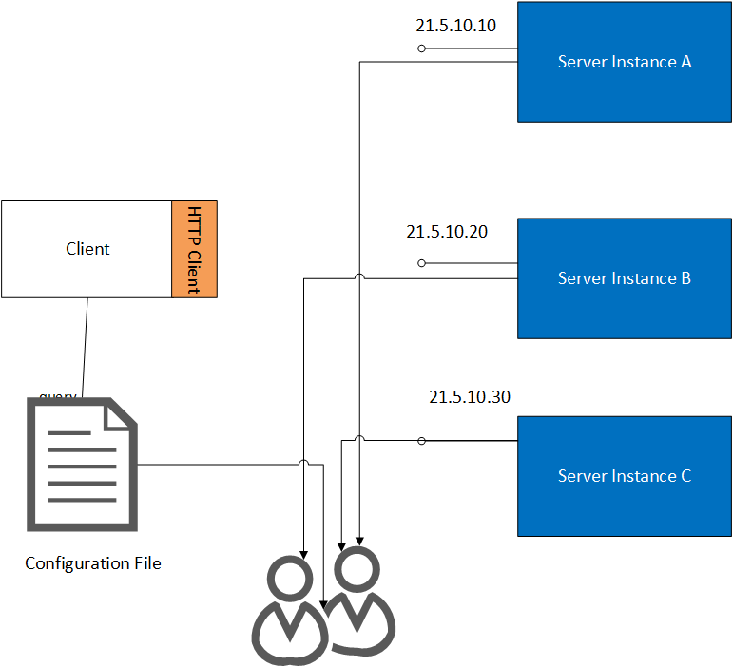
Local Registry
The simplest option, in that it requires no additional tooling, is for the service to read a local configuration files to obtain a pool of servers.
The client reads that file to acquire it’s own pool of servers
The client then needs to determine which server to pick, usually via a Round Robin Algorithm.
Notes:
The simplest option, in that it requires no additional tooling, is for the service to read a local configuration files to obtain a pool of servers.
The client reads that file to acquire it’s own pool of servers
The client then needs to determine which server to pick, usually via a Round Robin Algorithm.

Slide 22
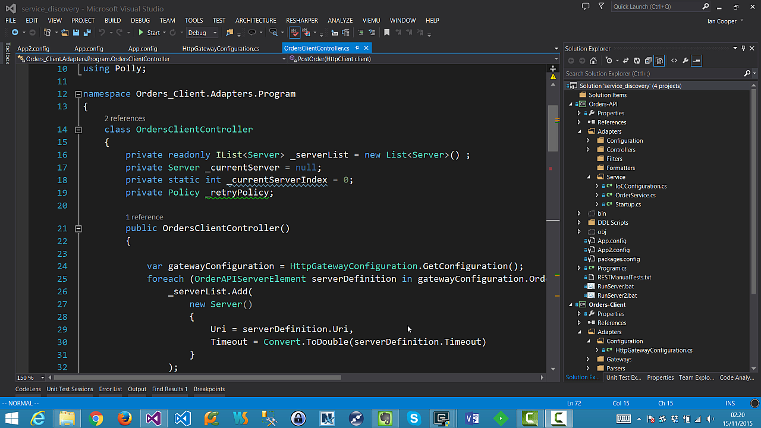
Demo: Local Registration
In this demo we look at using the configuration file of the application to provide a pool of servers which we can talk to, if our first server fails.
We will also look at how this approach copes with the loss of a server.

Slide 23
Advantages
Easy to implement
Most developers already have the skills to work with a configuration system(s) for their platform.
The pool of resources is a simple list, and the process of iterating over the list is straightforward.
You can load balance using a simple Round-Robin algorithm.

Slide 24
Disadvantages
Frequent changes to service locations are problematic require re-distributing the application.
Configuration has to be updated for new service deployments, as well as for hosts failing or being added/replaced.
No health checks, so we try services that are failing, and re-route once they fail.
Notes:
In environments with auto-scaling or manual scaling frequent changes to service locations are problematic as they require re-distributing the application to distribute the configuration.
Configuration has to be updated for new service deployments, as well as for hosts failing or being added/replaced.
No health checks, so we try services that are failing, and re-route once they fail.

Slide 25
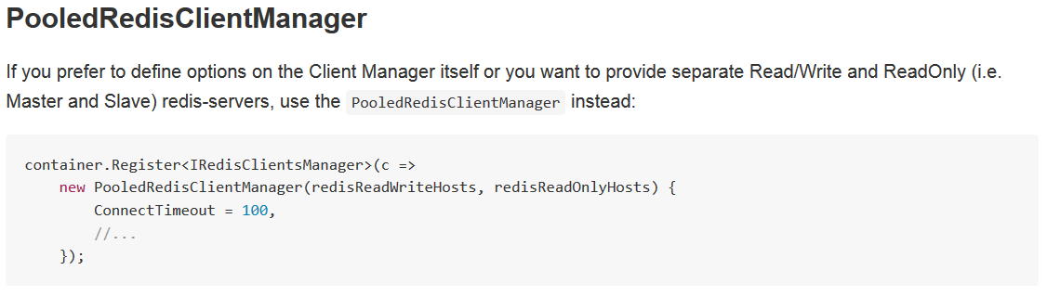
If you use ServiceStack.Redis, then you are using this approach to availability, in production, today.

Slide 26
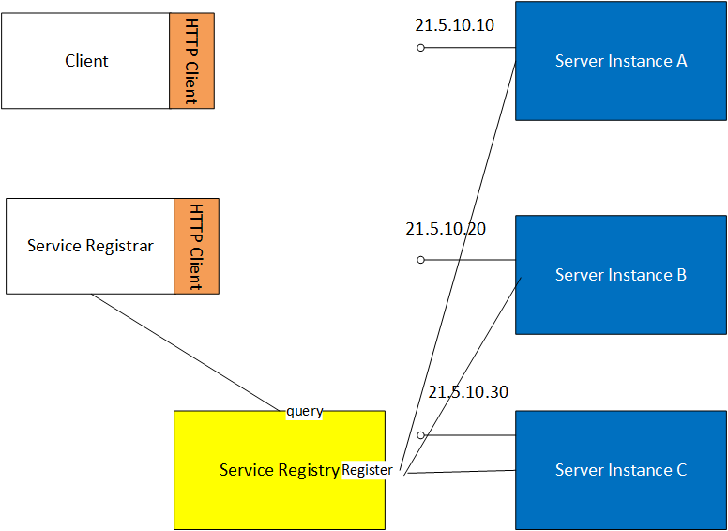
Server Registration
We can store configuration on a dedicated server.
The simplest form of registration server is just a key-value store.
Your registration server becomes a new point of failure.
Clustering can be used to protect your registration server
Notes:
We can store configuration on a dedicated server.
The simplest form of registration server is just a key-value store.
You can use Redis as a registration server if it is already part of your infrastructure.
Of course, your registration server becomes a new point of failure, if clients cannot get hold of it, they can find the pool of servers.
So your registration server must itself use redundancy to avoid availability concerns.
The usual redundancy model chosen is a cluster.

Slide 27





Registration Servers
Zookeeper: CP, register on start-up, deregister when done, list currently registered services, subscribe to notifications on ones that leave. Java and C libraries only.
AirBnB SmartStack: CP, Hadoop + Zookeeper
Netflix Eureka: AP, registration server with cached client that polls, register service on start-up and send heartbeat. REST and Java, designed for use on AWS
etcd: CP, key-value store, Raft for consensus, has an HTTP+JSON API
SKyDNS: CP, Raft for consensus, has both HTTP + JSON API and DNS support.
Consul: CP, Raft for consensus, has both HTTP + JSON API and DNS support.

Slide 28
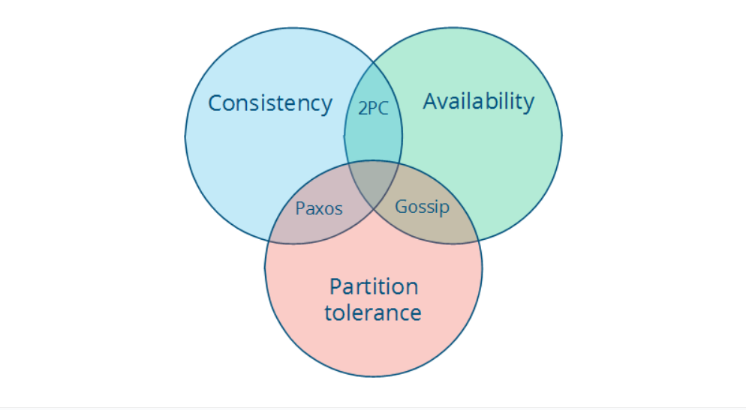
CAP Theorem
Created by Eric Brewer between 1998-2000.
In a distributed system, of these three properties, you can pick can two.
Consistency (all nodes agree on the state)
Availability (you get a response from one of the nodes when you make a request)
Partition tolerance (if nodes cannot communicate, or communicate at too high a latency, the system continues to offer service)
Usually short-handed to you can choose CP, or AP (or CA if P indicates catastrophic failure)
Distributed Systems for Fun and Profit http://book.mixu.net/distsys/single-page.html

Slide 29
Consul
FOSS, created by Hashicorp
Provides service discovery
Either DNS and HTTP+JSON
Can use health checks to ensure service catalogue is up to date

Slide 30
Getting Started
Download Consul from Hashicorp
https://www.consul.io/intro/getting-started/install.html
Via NuGet install the PlayFab .NET client for Consul
Documentation on their GitHub page
Examples provided in the project.

Slide 31
Agent
Long running service on every member of the cluster
Client or Server mode
Client runs on server hosting services; forwards requests to Server
Server maintains the catalogue of services
Uses Gossip protocol
Manages membership of cluster and broadcasts messages
WAN and LAN protocols
Uses RAFT algorithm
Provides consensus amongst Server nodes; allows election of leader
All requests forwarded to leader; leader forwards all transactions to followers
Allows loss of node(s)

Slide 32
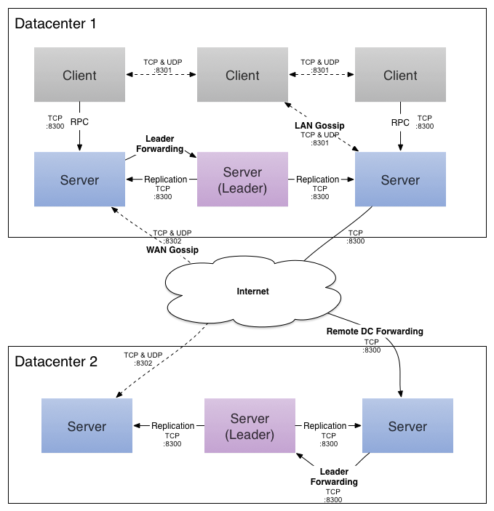
From: https://www.consul.io/docs/internals/architecture.html
Notes:
Agent - An agent is the long running daemon on every member of the Consul cluster. It is started by running consul agent. The agent is able to run in either client or server mode. Since all nodes must be running an agent, it is simpler to refer to the node as being either a client or server, but there are other instances of the agent. All agents can run the DNS or HTTP interfaces, and are responsible for running checks and keeping services in sync.
Client - A client is an agent that forwards all RPCs to a server. The client is relatively stateless. The only background activity a client performs is taking part in the LAN gossip pool. This has a minimal resource overhead and consumes only a small amount of network bandwidth.
Server - A server is an agent with an expanded set of responsibilities including participating in the Raft quorum, maintaining cluster state, responding to RPC queries, exchanging WAN gossip with other datacenters, and forwarding queries to leaders or remote datacenters.
Datacenter - While the definition of a datacenter seems obvious, there are subtle details that must be considered. For example, in EC2, are multiple availability zones considered to comprise a single datacenter? We define a datacenter to be a networking environment that is private, low latency, and high bandwidth. This excludes communication that would traverse the public internet, but for our purposes multiple availability zones within a single EC2 region would be considered part of a single datacenter.
Consensus - When used in our documentation we use consensus to mean agreement upon the elected leader as well as agreement on the ordering of transactions. Since these transactions are applied to a finite-state machine, our definition of consensus implies the consistency of a replicated state machine. Consensus is described in more detail on Wikipedia, and our implementation is described here.
Gossip - Consul is built on top of Serf which provides a full gossip protocol that is used for multiple purposes. Serf provides membership, failure detection, and event broadcast. Our use of these is described more in the gossip documentation. It is enough to know that gossip involves random node-to-node communication, primarily over UDP.
LAN Gossip - Refers to the LAN gossip pool which contains nodes that are all located on the same local area network or datacenter.
WAN Gossip - Refers to the WAN gossip pool which contains only servers. These servers are primarily located in different datacenters and typically communicate over the internet or wide area network.
RPC - Remote Procedure Call. This is a request / response mechanism allowing a client to make a request of a server.
Within each datacenter, we have a mixture of clients and servers. It is expected that there be between three to five servers. This strikes a balance between availability in the case of failure and performance, as consensus gets progressively slower as more machines are added. However, there is no limit to the number of clients, and they can easily scale into the thousands or tens of thousands.
All the nodes that are in a datacenter participate in a gossip protocol. This means there is a gossip pool that contains all the nodes for a given datacenter. This serves a few purposes: first, there is no need to configure clients with the addresses of servers; discovery is done automatically. Second, the work of detecting node failures is not placed on the servers but is distributed. This makes failure detection much more scalable than naive heartbeating schemes. Thirdly, it is used as a messaging layer to notify when important events such as leader election take place.
The servers in each datacenter are all part of a single Raft peer set. This means that they work together to elect a single leader, a selected server which has extra duties. The leader is responsible for processing all queries and transactions. Transactions must also be replicated to all peers as part of the consensus protocol. Because of this requirement, when a non-leader server receives an RPC request, it forwards it to the cluster leader.
The server nodes also operate as part of a WAN gossip pool. This pool is different from the LAN pool as it is optimized for the higher latency of the internet and is expected to contain only other Consul server nodes. The purpose of this pool is to allow datacenters to discover each other in a low-touch manner. Bringing a new datacenter online is as easy as joining the existing WAN gossip. Because the servers are all operating in this pool, it also enables cross-datacenter requests. When a server receives a request for a different datacenter, it forwards it to a random server in the correct datacenter. That server may then forward to the local leader.
This results in a very low coupling between datacenters, but because of failure detection, connection caching and multiplexing, cross-datacenter requests are relatively fast and reliable.

Slide 33
Consul provides the following HTTP + JSON endpoints for interacting with Consul:
acl - setup access control lists and security for Consul
agent - api for dealing with agent
catalog - dealing with datacenter catalog
event - fire fast gossip based events
health - show health checks
kv - key value
Query - prepared queries
session - group operations and manage consistent view
status - check status

Slide 34
Service Registrar (Sidecar)
In Service Registrar Registration another process (sometimes called a sidecar) does the heavy lifting around registering the services.

Slide 35
Demo: Service Registrar
Although we only run this once in the demo, in principle the registrar can run as a scheduled job and thus continually update registrations, or listen for events that tell it new services are available to register.
In practice this relies on the service reloading the configuration automatically when an operator updates it for new registrations.

Slide 36
Advantages
Easy to implement
The pool of resources is a simple list, and the process of iterating over the list is straightforward.
You can load balance using a simple Round-Robin algorithm.
Services are not dependent on the registration server implementation that we are using.
This also means we can use this approach for services that we did not write ourselves.
You can use projects like Registrator if you are working with Docker
Notes:
Easy to implement
The pool of resources is a simple list, and the process of iterating over the list is straightforward.
You can load balance using a simple Round-Robin algorithm.
Services are not dependent on the registration server implementation that we are using. So only the client and registrar need to be change if we decide to switch that out.
This also means we can use this approach for services that we did not write ourselves.
You can use projects like Registrator if you are working with Docker, which inspects new Docker containers for servers and registers them (supports multiple OSS Service Registries)

Slide 37
Disadvantages
Frequent changes to service locations require re-configuring the registrar.
We now have a dependency on our Service Registrar and Registration Service.
Notes:
In environments with auto-scaling or manual scaling frequent changes to service locations are still problematic as they require re-configuring the registrar to update the registration server with the new locations.
We now have a dependency on our Service Registrar and Registration Service to run in production. So we have to worry about make these highly available as well, or they become our point of failure.

Slide 38
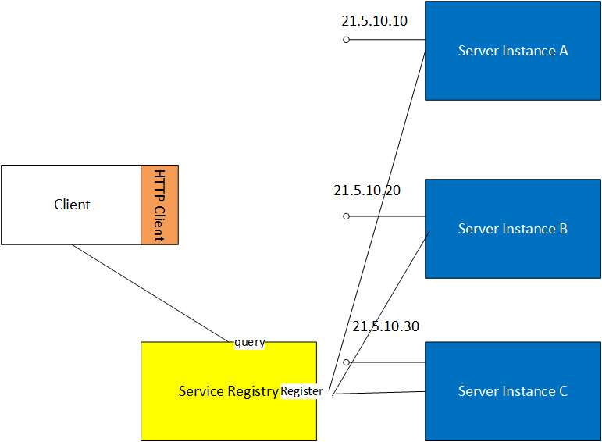
Self-Registration
In self-registration a server simply registers itself with the registration service at start-up and de-registers itself at shutdown.
This means that there is no sidekick service required, services simply take themselves in and out of the pool as the come online and go offline.
The client queries the registry for the pool as before.

Slide 39
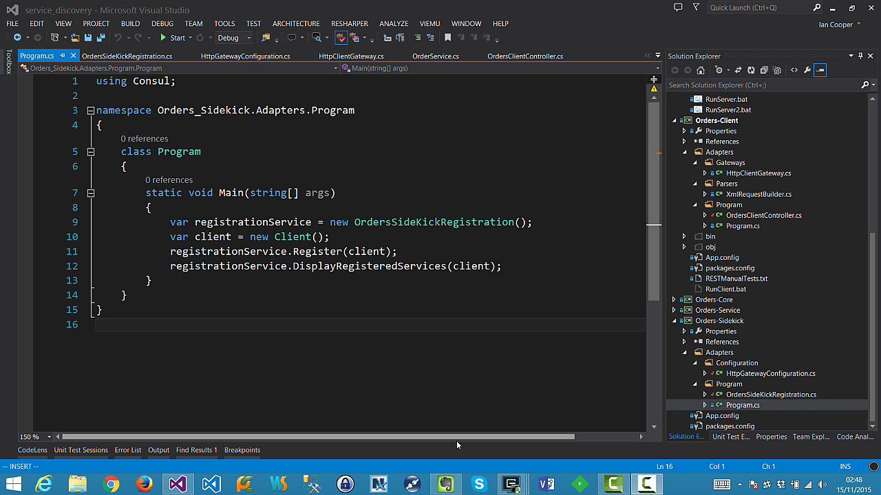
Demo: Self-Registration
In this demo we show a service registering itself at start-up, and de-registering itself at shutdown.
Note that in the event of disorderly shutdown (i.e. kill process) we do not deregister the service.

Slide 40
Advantages
Handles dynamic environments
As a server is self-registering so it adds it self to the pool.
You can load balance using a simple Round-Robin algorithm.

Slide 41
Disadvantages
Service now has a dependency on the registration service. If we wish to change our registration service, we need to update services not sidecars.
We have more dependencies on the Registration Service, so again, we need to ensure that it is clustered.
Does not work for apps that we do not own and thus cannot make self-register
No health checks, so we try services that are failing, and re-route only once they fail.

Slide 42
Health Checks

Slide 43
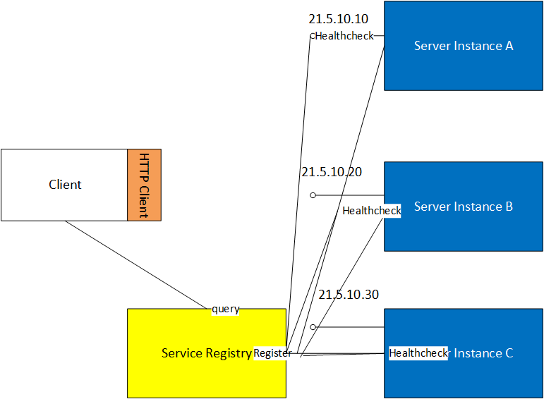
Health Check
A health check reduces the problem that we may round-robin to a dead server (as we do in our examples so far).
If the service is not valid, we can take it out of the pool when we look for a server to use.
A health check can be:
A custom script that the registration server calls
A GET against an HTTP endpoint, 2xx is alive, anything else is dead
A call by the server to the registration service to renew a lease before it times out.

Slide 44
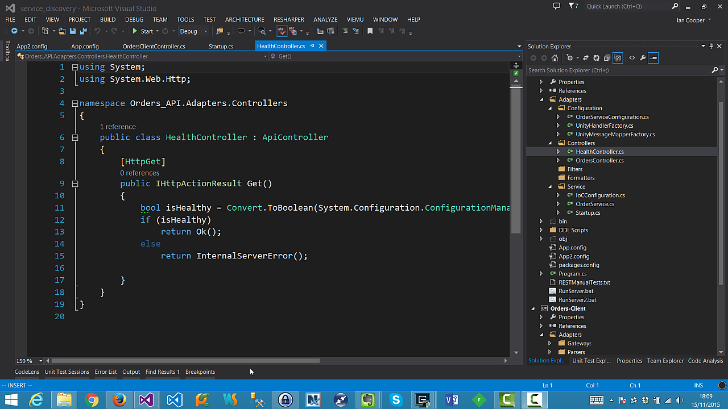
Health Checks
Is my server alive?
We don’t show here that you would want to poll on a regular basis and update your list.

Slide 45
Server-Side Discovery

Slide 46
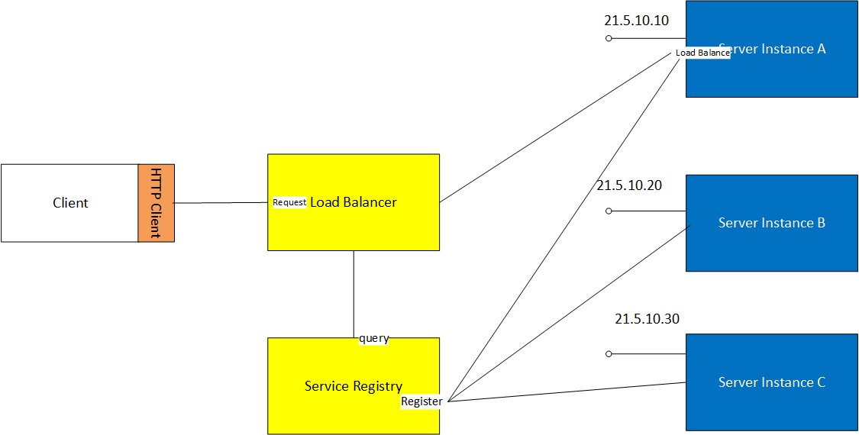
Hardware or Software Load Balancer
Load Balancers
A Load Balancer (LB) is a common solution to making a pool of servers available to clients.
A service is registered with an IP address (sometimes called a Virtual IP or VIP) that is given to clients; that IP address represents not (necessarily) an individual server but a pool of servers.
The LB then uses a scheduling algorithm such as Round-Robin to distribute requests to the pool.
An LB can support ‘sticky’ sessions where the server holds state.
The LB can use health checks to determine if servers should be in the pool.

Slide 47
Advantages
It’s not a software developer problem to do load balancing, we just buy some dedicated kit.
An LB typically has some useful additional features such as SSL termination, priority queueing, DDOS protection, firewall etc.

Slide 48
Disadvantages
The LB itself could become a single point of failure, so we need to have active-active or active-passive redundancy.
The LB still needs to be configured with the IP addresses of the server in the pool.
An LB is mostly used in an external facing role. To use the LB internally it either needs to be dedicated to that role, or expose the services externally.
Notes:
The LB itself could become a single point of failure, so we need to have active-active or active-passive redundancy.
The LB still needs to be configured with the IP addresses of the server in the pool. This may be problematic as we have to understand how servers will register with the LB when they spin up and shut down.
An LB is mostly used in an external facing role. To use the LB internally it either needs to be dedicated to that role, or expose the services externally. For example, to use an AWS ELB in an internal load-balancing role you need to use a Virtual Private Cloud (VPC), not EC2 classic.

Slide 49
Service Registration and Load Balancers
It is possible to have the Load Balancer and Service Registration work together.
In this approach the Service Registry updates the Load Balancer when a new service appears, or one fails its health checks and should be removed.

Slide 50
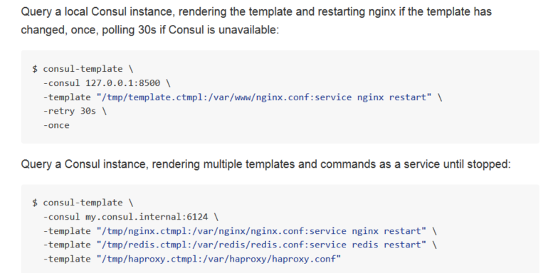
Service Registration and Load Balancers
For example Consul-Template can be used to update configuration files from a template using the values in the Service Registry (service of just key-value pair).
This can then update the configuration of a Varnish, nginx, or HA-Proxy proxy acting as a load balancer.
https://github.com/hashicorp/consul-template

Slide 51
Zero Configuration

Slide 52
DNS-SD
DNS-SD allows clients to use DNS queries to discover a named list of service instances.
Each service instance is described using a DNS SRV and DNS TXT record.
A client queries the DNS PTR record of that service type's name;
The server returns zero or more names of the form "<Service>.<Domain>", each corresponding to a SRV/TXT record pair.
The SRV record resolves to the domain name providing the instance, while the TXT can contain service-specific configuration parameter.
A client can then resolve the A/AAAA record for the domain name and connect to the service.

Slide 53
DNS-SD for .NET
.NET core libraries don’t support querying an arbitrary DNS Server
You have to use the DNS Server configured for the host machine.
Hard to get user without redirecting from SD registry
Third Party Libraries
You can find third party libraries that let you query an arbitrary DNS store
Overall, it’s probably easier just to use HTTP + JSON from .NET code
Reserve DNS-SD for clients that can’t consume that API

Slide 54
Key-Value Configuration Store
You should note
A Service Catalogue is just a Key-Value store
Most let you query the store itself over the HTTP + JSON API
This means you can store configuration properties in the registry
So configuration properties for services that are not machine dependent can be stored here

Slide 55
For everything else….
…There are environment variables

Slide 56
In other words, no more templated configuration files

Slide 57
Conclusion

Slide 58
What Did You Learn From This Session?
Service Discovery is runtime discovery of service location
If you have more than one process you need it for availability
You can use Client (Sidecar, Self) or Server Discovery
Zookeeper, Consul, etcd. are service registries
Distributed Key-Value stores. Most support HTTP+JSON
Query registry at run-time for configuration information
Fairly straightforward
Most of the technology associated helps to make this robust.
Notes:
This is intended as an introduction to the topic of Service Discovery
Once you know what it is, it’s quite simple to use it
Of course the trick is in knowing what it is, and that is the point of this presentation.
It’s not deep dive

Slide 59
Q&A

